Slide 1


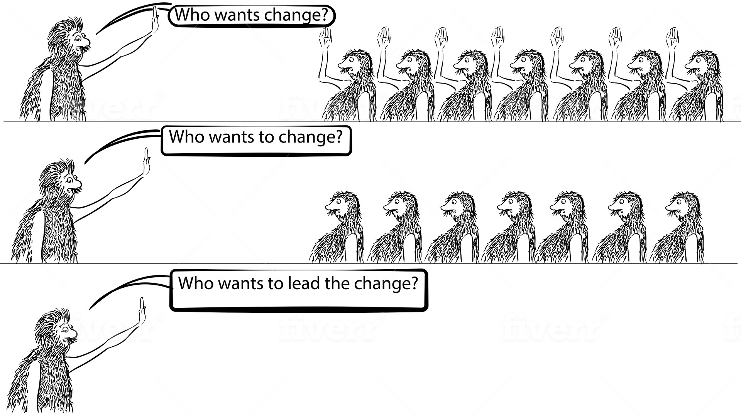
Status Update – 20th May

Slide 2
Dashboard
Engagement
Download Status | Learn Status
Nudges
Question | Response
Have you noticed a reduction in Documentation Errors over the last month? | 453
How many documentation errors you made this week? | 251
Have you noticed any wrong date entries in the last month? | 252
Why do you think we have errors in documentation? | 432
This week, did you feel unnecessary pressure at work? | 351
Missing entry/sign/date is the most common documentation error observed by the managers. Why do you see this as the biggest challenge? | 379
Often the recommendation for reducing documentation error is to increase training. What is the challenge with current training? | 360
Is there sufficient communication and retraining on changes in guidelines, documentation and SOPs? | 423

Slide 3
Dashboard
Issues
None
Insight
Awareness about documentation error is there People have seen wrong date entries Main reason for error are People attitude & Work Pressure Frequency of training can be improved
Next Week Nudges
Data Integrity – Knowledge Check Data Integrity – Gaps April Appreciation

Slide 4
Download Status
Location | Downloaded | Yet to Download | Total | % Download
Unit 1 | 112 | 43 | 155 | 72%
Unit 2 | 206 | 55 | 261 | 79%
Unit 3 | 221 | 31 | 252 | 88%
Total | 539 | 129 | 668 | 81%
Level | Downloaded | Yet to Download | Total | % Download
Junior | 396 | 100 | 496 | 80%
Middle | 112 | 20 | 132 | 85%
Senior | 31 | 9 | 40 | 78%
Total | 539 | 129 | 668 | 81%

Slide 5
Learn Status
Location | GDP | Data Integrity | Not On Learn | Total
Unit 1 | 43 | 15 | 54 | 112
Unit 2 | 99 | 19 | 88 | 206
Unit 3 | 95 | 28 | 98 | 221
Total | 237 | 62 | 240 | 539
Level | GDP | Data Integrity | Not On Learn | Total
Junior | 175 | 41 | 180 | 396
Middle | 52 | 18 | 42 | 112
Senior | 10 | 3 | 18 | 31
Total | 237 | 62 | 240 | 539

Slide 6
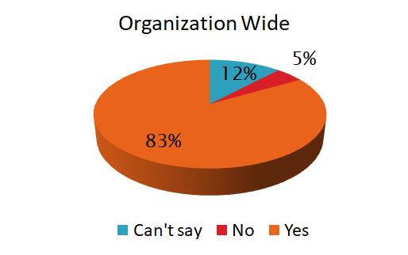
Have you noticed a reduction in Documentation Errors over the last month?
Response | Unit 1 | Unit 2 | Unit 3
Can't Say | 6.67% | 15.25% | 11.29%
No | 0.00% | 6.78% | 4.84%
Yes | 93.33% | 77.97% | 83.87%
Total | 100.00% | 100.00% | 100.00%
Response | Junior | Middle | Senior
Can't Say | 7.62% | 20.51% | 28.57%
No | 3.81% | 5.13% | 14.29%
Yes | 88.57% | 74.36% | 57.14%
Total | 100.00% | 100.00% | 100.00%

Slide 7
How many documentation errors you made this week?
Reasons | Unit 1 | Unit 2 | Unit 3
0 | 74.07% | 69.77% | 83.33%
1 | 22.22% | 16.28% | 7.41%
2 | 3.70% | 13.95% | 9.26%
Total | 100.00% | 100.00% | 100.00%
Reasons | Junior | Middle | Senior
0 | 69.05% | 91.67% | 100.00%
1 | 16.67% | 8.33% | 0.00%
2 | 14.29% | 0.00% | 0.00%
Total | 100% | 100% | 100%

Slide 8
Have you noticed any wrong date entries in the last month?
Response | Unit 1 | Unit 2 | Unit 3
Yes | 31.25% | 32.00% | 34.88%
No | 68.75% | 68.00% | 65.12%
Total | 100.00% | 100.00% | 100.00%
Response | Junior | Middle | Senior
Yes | 31.03% | 36.36% | 50.00%
No | 68.97% | 63.64% | 50.00%
Total | 100.00% | 100.00% | 100.00%

Slide 9
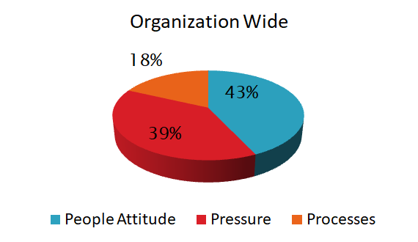
Why do you think we have errors in documentation?
Reasons | Unit 1 | Unit 2 | Unit 3
People Attitude | 40.00% | 50.00% | 38.33%
Pressure | 36.67% | 29.63% | 48.33%
Processes | 23.33% | 20.37% | 13.33%
Total | 100.00% | 100.00% | 100.00%
Reasons | Junior | Middle | Senior
People Attitude | 33.01% | 68.57% | 66.67%
Pressure | 45.63% | 20.00% | 33.33%
Processes | 21.36% | 11.43% | 0.00%
Total | 100.00% | 100.00% | 100.00%

Slide 10
This week, did you feel unnecessary pressure at work?
Response | Unit 1 | Unit 2 | Unit 3
No | 51.85% | 38.10% | 50.00%
Sometimes | 14.81% | 33.33% | 30.36%
Yes | 33.33% | 28.57% | 19.64%
Total | 100% | 100% | 100%
Reasons | Junior | Middle | Senior
No | 45.45% | 50.00% | 40.00%
Sometimes | 27.27% | 31.25% | 20.00%
Yes | 27.27% | 18.75% | 40.00%
Total | 100% | 100% | 100%

Slide 11
Missing entry/sign/date is the most common documentation error observed by the managers. Why do you see this as the biggest challenge?
Response | Unit 1 | Unit 2 | Unit 3
Lack of Diligence | 60.00% | 57.50% | 64.41%
Lack of Knowledge | 16.67% | 15.00% | 20.34%
Other | 23.33% | 27.50% | 15.25%
Total | 100% | 100% | 100%
Response | Junior | Middle | Senior
Lack of Diligence | 52.87% | 80.00% | 71.43%
Lack of Knowledge | 19.54% | 14.29% | 14.29%
Other | 27.59% | 5.71% | 14.29%
Total | 100% | 100% | 100%

Slide 12
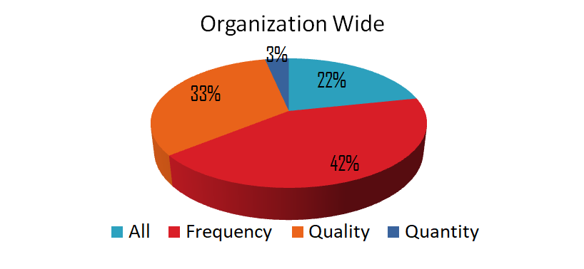
Often the recommendation for reducing documentation error is to increase training. What is the challenge with current training?
Response | Unit 1 | Unit 2 | Unit 3
All | 21.74% | 11.11% | 30.77%
Frequency | 60.87% | 37.78% | 38.46%
Quality | 17.39% | 44.44% | 28.85%
Quantity | 0.00% | 6.67% | 1.92%
Total | 100.00% | 100.00% | 100.00%
Response | Junior | Middle | Senior
All | 25.88% | 13.33% | 0.00%
Frequency | 37.65% | 53.33% | 60.00%
Quality | 35.29% | 26.67% | 20.00%
Quantity | 1.18% | 6.67% | 20.00%
Total | 100.00% | 100.00% | 100.00%

Slide 13
Is there sufficient communication and retraining on changes in guidelines, documentation and SOPs?
Reasons | Unit 1 | Unit 2 | Unit 3
N/A | 3.13% | 0.00% | 0.00%
No | 3.13% | 6.38% | 11.86%
Some | 18.75% | 27.66% | 16.95%
Yes | 75.00% | 65.96% | 71.19%
Total | 100% | 100% | 100%
Reasons | Junior | Middle | Senior
N/A | 0.00% | 2.78% | 0.00%
No | 6.32% | 11.11% | 14.29%
Some | 21.05% | 16.67% | 42.86%
Yes | 72.63% | 69.44% | 42.86%
Total | 100% | 100% | 100%

Slide 14
Thank You
www.seek-app.com

